Slide 2
Overview
Part 1 - Storage Elements and Analysis
Introduction to sequential circuits
Types of sequential circuits
Storage elements
Latches
Flip-flops
Sequential circuit analysis
State tables
State diagrams
Circuit and System Timing
Part 2 - Sequential Circuit Design
Specification
Assignment of State Codes
Implementation

Slide 3
Introduction to Sequential Circuits
Inputs
Outputs
Combina-tional
Logic
A Sequential circuit contains:
Storage elements: Latches or Flip-Flops
Combinatorial Logic:
Implements a multiple-output switching function
Inputs are signals from the outside.
Outputs are signals to the outside.
Other inputs, State or Present State, are signals from storage elements.
The remaining outputs, Next State are inputs to storage elements.
Storage Elements
Next
State
State

Slide 4
Introduction to Sequential Circuits
Combinatorial Logic
Next state function Next State = f(Inputs, State)
Output function (Mealy) Outputs = g(Inputs, State)
Output function (Moore) Outputs = h(State)
Output function type depends on specification and affects the design significantly
Outputs
Inputs
Combina-tional
Logic
Storage Elements
Next
State
State

Slide 5
Types of Sequential Circuits
Depends on the times at which:
storage elements observe their inputs, and
storage elements change their state
Synchronous
Behavior defined from knowledge of its signals at discrete instances of time
Storage elements observe inputs and can change state only in relation to a timing signal (clock pulses from a clock)
Asynchronous
Behavior defined from knowledge of inputs an any instant of time and the order in continuous time in which inputs change
If clock just regarded as another input, all circuits are asynchronous!
Nevertheless, the synchronous abstraction makes complex designs tractable!

Slide 6
Synchronous Clocked Sequential Circuit
Inputs
Combinational circuit
Outputs
Flip Flops
Next state
Present state
Timing signal (clock)
Clock
a periodic external event (input)
Clock
synchronizes when current state changes happen
keeps system well-behaved
makes it easier to design and build large systems

Slide 7
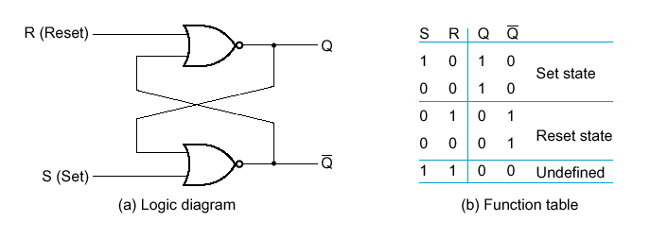
Basic (NOR) S – R Latch
SR latch is made from two cross-coupled NORs
Usually S=0 and R=0
When Q = 1, the SR-Latch is in the Set state
When Q = 0, the SR-Latch is in the Reset state
S=1 and R=1 generates illogical results

Slide 8
Basic (NOR) S – R Latch
Cross-coupling two NOR gates gives the S – R Latch:
Which has the time sequence behavior:
R (reset)
Q
S (set)
Q
Time
R
S
Q
Q
Comment
0
0
?
?
Stored state unknown
0
1
1
0
“Set” Q to 1
0
0
1
0
Now Q “remembers” 1
1
0
0
1
“Reset” Q to 0
0
0
0
1
Now Q “remembers” 0
1
1
0
0
Both go low
0
0
?
?
Unstable!

Slide 9
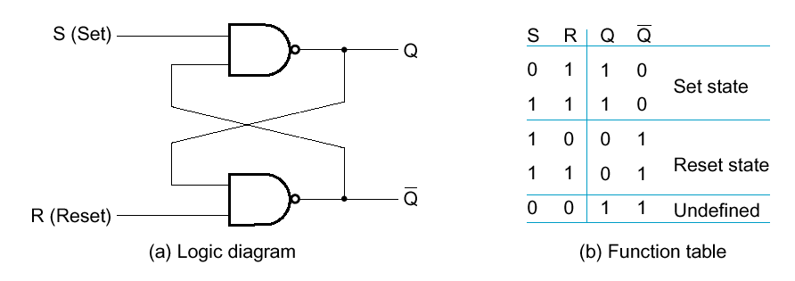
Basic (NAND) S – R Latch
SR latch is made from two cross-coupled NANDs
Sometimes called S R latch
Usually S=1 and R=1
S=0 and R=0 generates illogical results

Slide 10
Basic (NAND) S – R Latch
“Cross-Coupling” two NAND gates gives the S -R Latch:
Which has the time sequence behavior:
S = 0, R = 0 is forbidden as input pattern
S (set)
Q
Q
R (reset)
Time
R
S
Q
Q
Comment
1
1
?
?
Stored state unknown
1
0
1
0
“Set” Q to 1
1
1
1
0
Now Q “remembers” 1
0
1
0
1
“Reset” Q to 0
1
1
0
1
Now Q “remembers” 0
0
0
1
1
Both go high
1
1
?
?
Unstable!

Slide 11
Clocked S - R Latch
Adding two NAND gates to the basic S - R NAND latch gives the clocked S – R latch:
Has a time sequence behavior similar to the basic S-R latch except that the S and R inputs are only observed when the line C is high.
C means “control” or “clock”.
S
Q
C
Q
R

Slide 12
Clocked S - R Latch (continued)
The Clocked S-R Latch can be described by a table:
The table describes what happens after the clock [at time (t+1)] based on:
current inputs (S,R) and
current state Q(t).
S
Q
C
Q
R

Slide 13
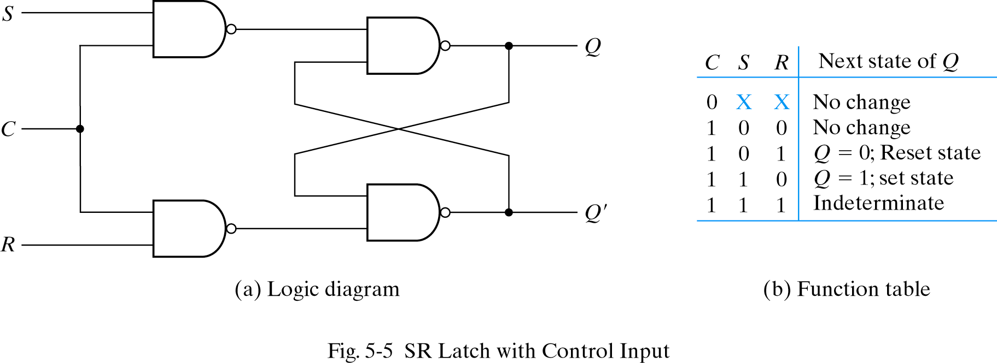
Clocked S - R Latch (continued)
Avoid uncontrolled latch changes
C = 0 disables all latch state changes
Control signal enables data change when C = 1

Slide 14
D Latch
Adding an inverter to the S-R Latch, gives the D Latch:
Note that there are no “indeterminate” states!
D
Q
C
Q
Q
D
Q(t+1)
Comment
0
0
0
No change
D
Q
0
1
1
Set Q
1
0
0
Clear Q
C
Q
1
1
1
No Change

Slide 15
Flip-Flops
The latch timing problem
Master-slave flip-flop
Edge-triggered flip-flop
Standard symbols for storage elements
Direct inputs to flip-flops
Flip-flop timing

Slide 16
The Latch Timing Problem
In a sequential circuit, paths may exist through combinational logic:
From one storage element to another
From a storage element back to the same storage element
The combinational logic between a latch output and a latch input may be as simple as an interconnect
For a clocked D-latch, the output Q depends on the input D whenever the clock input C has value 1

Slide 17
The Latch Timing Problem (continued)
Consider the following circuit:
Suppose that initially Y = 0.
As long as C = 1, the value of Y continues to change!
The changes are based on the delay present on the loop through the connection from Y back to Y.
This behavior is clearly unacceptable.
Desired behavior: Y changes only once per clock pulse
Y
D
Q
Clock
C
Q
Clock
Y

Slide 18
The Latch Timing Problem (continued)
A solution to the latch timing problem is to break the closed path from Y to Y within the storage element
The commonly-used, path-breaking solutions replace the clocked D-latch with:
a master-slave flip-flop
an edge-triggered flip-flop

Slide 19
S-R Master-Slave Flip-Flop
Consists of two clocked S-R latches in series with the clock on the second latch inverted
The input is observed by the first latch with C = 1
The output is changed by the second latch with C = 0
The path from input to output is broken by the difference in clocking values (C = 1 and C = 0).
The behavior demonstrated by the example with D driven by Y given previously is prevented since the clock must change from 1 to 0 before a change in Y based on D can occur.
S
S
Q
S
Q
Q
C
C
C
R
R
Q
R
Q
Q

Slide 20
J-K Flip-flop
Behavior
Same as S-R flip-flop with J analogous to S and K analogous to R
Except that J = K = 1 is allowed, and
For J = K = 1, the flip-flop changes to the opposite state
As a master-slave, has same behavior as S-R flip-flop
If the master changes to the wrong state, that state will be passed to the slave
E.g., if master falsely set by J = 1, K = 1 cannot reset it during the current clock cycle

Slide 21
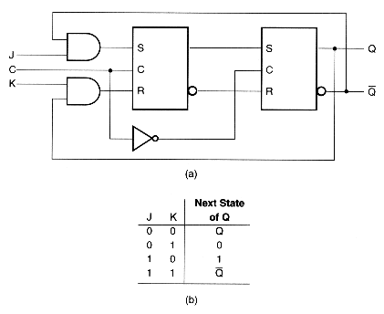
J-K Flip-flop (continued)
J
C
K

